Slide 1




HACKED- 3.0
EDU FLOW
C-2 – HACK HUSTLERS
TEAM MEMBERS NAME – SHIVENDRA NATH DWIVEDI, VINAYAK BHAT, KETAN SAINI, DHRUV SHARMA

Slide 2
Problem Statement
Inefficient Scheduling
No Cancellation System
Lack of Real-Time Updates
Manual systems are prone to errors. Labor-intensive.
Lack of a claiming free slots process.
Students and teachers get outdated info.

Slide 3
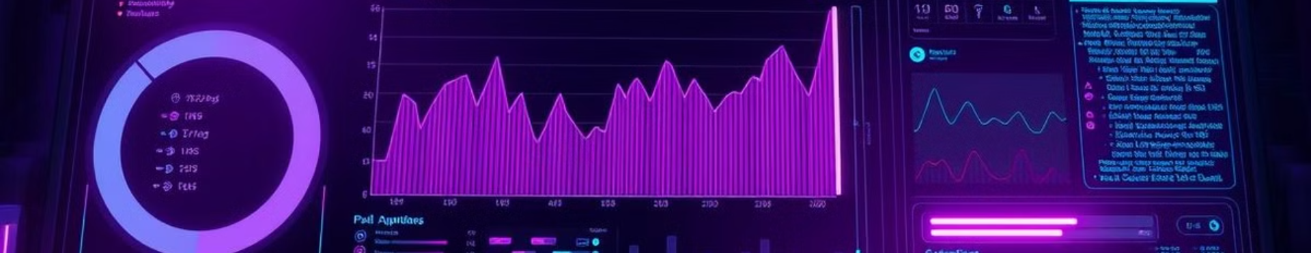



Edu-Flow Solution
Friendly Interface
Real-Time Updates
Role-Based Authentication
Easy scheduling and management.
Notifications for schedule changes.
Specific student and teacher access.

Slide 4

Key Features
Students
Schedule management
Class change updates
Teachers
Class cancellation
Free slot release
Claim available slots

Slide 5
Workflow
Login
1
Student/Teacher logs in
2
Timetable
Input timetable
Updates
3
Teacher updates/cancels
4
Claim
Teacher claims slots
Notify
5
System notifies changes

Slide 6

Edu-Flow Benefits
1
Enhanced Communication
2
Efficient Scheduling
Easy class management and cancellation.
Real-time updates reduce miscommunication.
3
Improved Transparency
Role-based access ensures data integrity.

Slide 7
TECHNOLOGIES USED
Frontend: HTML, CSS, JavaScript
Backend: Node.js, Express.js
Database: MongoDB Atlas
Authentication: JWT
Tools & Libraries: Firebase, Nodemon, bcrypt.js, Cors

Slide 8

Video Demo
See Edu-Flow in action. Watch our video.

Slide 9

Thank You
Questions? Contact us!

